Slide 1
Desktop Sized Screens
RESD Mock-ups

Slide 2
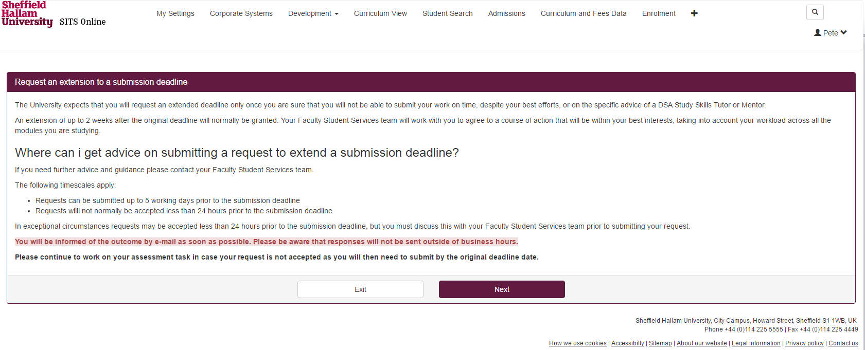

Slide 3
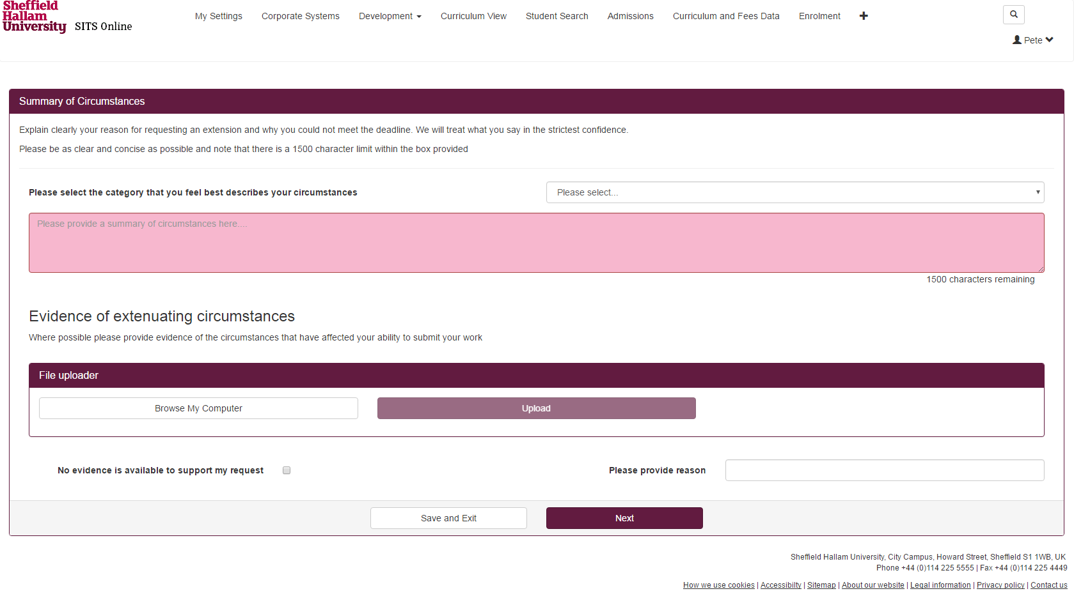

Slide 4
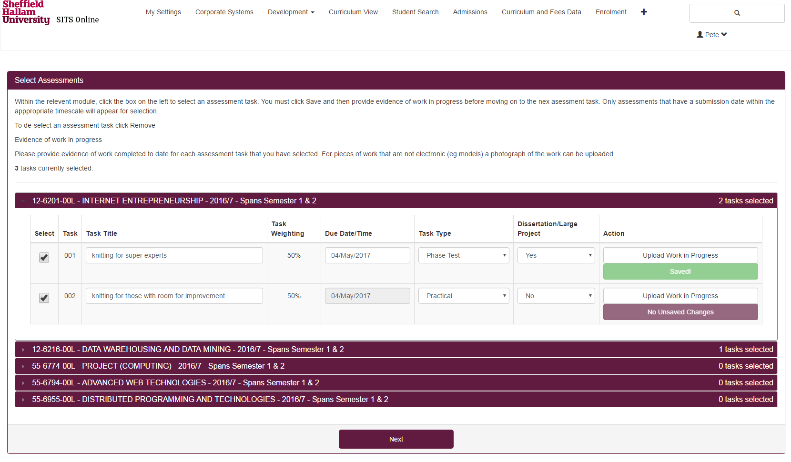

Slide 5
Mobile Sized Screens

Slide 6
